Slide 1


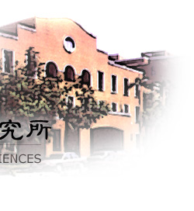

Vibrational Spectra of Solvated H₃O⁺
郭哲來 (Jer-Lai Kuo)
中央研究院原子分子科學研究所 Institute of Atomic and Molecular Sciences, Academia Sinica, Taipei, Taiwan
Joint Group Meeting, Dec/01/2016, IAMS, Taipei, Taiwan

Slide 2
Outline
Vib. modes of solvated H₃O⁺ & selected IRPD spectra
Case study on H₃O^{+…}Ar_{1,2&3}
Good Agreements. Let’s make some predictions!
Tuning H-bonds by using different rare gas tagging
Simple pictures derived from H₃O^{+…}RG₃
What else?
JPCA. 119, 10887 (2015)
PCCP. 18, 30721 (2016)

Slide 3
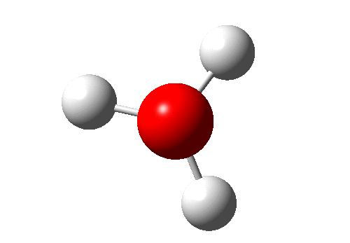
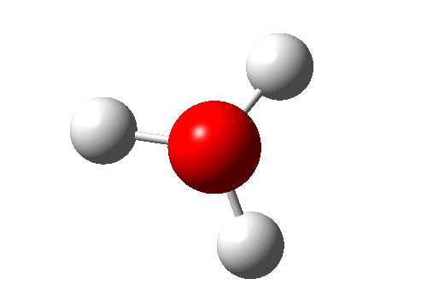
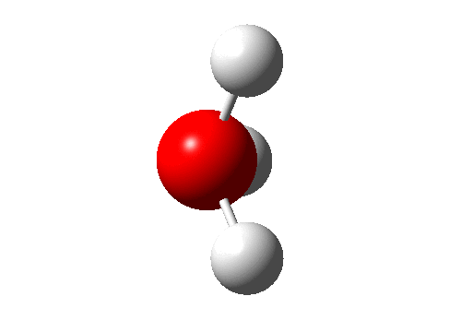
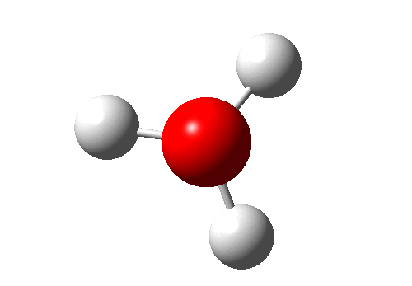
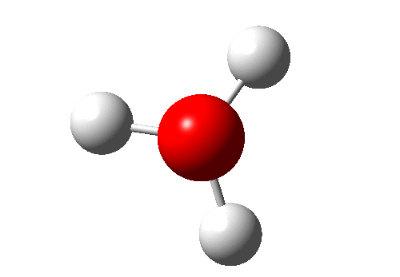
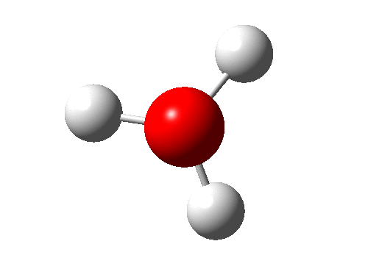
Freq. of Normal Modes H₃O^{+…}RG₃ (1)
umbrella ~904 cm⁻¹
bend
~1670 cm⁻¹
sym. strech ~3547cm⁻¹
asym. stretch
~3676cm⁻¹
Ar
~962 cm⁻¹
~1668 cm⁻¹
~3418cm⁻¹
~3491cm⁻¹
N₂
~1013 cm⁻¹
~1692 cm⁻¹
~3284cm⁻¹
~3305cm⁻¹
H₂O
~1202 cm⁻¹
~1708 cm⁻¹
~3009cm⁻¹
~2937cm⁻¹
Harmonic freq by MP2/aug-cc-pvDZ

Slide 4
6 Normal Modes of H₃O⁺
Ar ~ H₂O
(s₁, s₂, s₃) stretch of O-H bond (~in-plane) 3490 ~ 2900
(b₁, b₂, ) bend of H-O-H (~in-plane) 1670 ~ 1710
(u, ) umbrella motion of H₃O⁺(out-of-plane) 900 ~ 1200

Slide 5
6 Normal Modes of O…X₃
(S₁, S₂, S₃) stretch of O…X bond (~in-plane)
(B₁, B₂, ) bend of X…O…X (~in-plane)
(U, ) umbrella motion of H₃O⁺(out-of-plane)

Slide 6
Freq. of Normal Modes H₃O^{+…}RG₃ (2)
~ Translation of H₃O⁺
Ar
~ 100cm⁻¹
~ 150cm⁻¹
~ 100cm⁻¹
~ 150cm⁻¹
N₂
~ 175 cm⁻¹
~ 228cm⁻¹
~ 175 cm⁻¹
~ 228cm⁻¹
H₂O
~ 285 cm⁻¹
~ 344cm⁻¹
~ 285 cm⁻¹
~ 344cm⁻¹
Harmonic freq by MP2/aug-cc-pvDZ

Slide 7
3N-6 Normal Modes of H₃O^{+…}X₃
Ar ~ H₂O
(s₁, s₂, s₃) stretch of O-H bond (~in-plane) 3490 ~ 2900
(b₁, b₂, ) bend of H-O-H (~in-plane) 1670 ~ 1710
(b₁, b₂, ) bend of H-O-H (~in-plane)
(u, ) umbrella motion of H₃O⁺(out-of-plane) 900 ~ 1200
(u, ) umbrella motion of H₃O⁺(out-of-plane)
(S₁, S₂, S₃) stretch of O…X bond (~in-plane) 100 ~ 340
(B₁, B₂, ) bend of X…O…X (~in-plane) < 50
(U, ) umbrella motion of H₃O⁺(out-of-plane) < 50

Slide 8
Freq. of Normal Modes H₃O^{+…}RG₃ (2)
(x,y) Rotation of H₃O⁺ (z)
Ar
~368 cm⁻¹
~338 cm⁻¹
N₂
~617 cm⁻¹
~557 cm⁻¹
H₂O
~975 cm⁻¹
~725 cm⁻¹
Harmonic freq by MP2/aug-cc-pvDZ

Slide 9
3N-6 Normal Modes of H₃O^{+…}X₃
Ar ~ H₂O
(s₁, s₂, s₃) stretch of O-H bond (~in-plane) 3490 ~ 2900
(b₁, b₂, Φ) bend of H-O-H (~in-plane) 1670 ~ 1710
hinder rotation of H₃O⁺ 340 ~ 720
(b₁, b₂, ) bend of H-O-H (~in-plane)
(u, R₁, R₂) umbrella motion of H₃O⁺(out-of-plane) 900 ~ 1200
rocking of H₃O⁺ 370 ~ 970
(u, ) umbrella motion of H₃O⁺(out-of-plane)
(S₁, S₂, S₃) stretch of O…X bond (~in-plane)
translational motion of H₃O⁺ 100 ~ 340
(B₁, B₂, ) bend of X…O…X (~in-plane) < 50
(B₁, B₂, ) bend of X…O…X (~in-plane) < 50
(U, ) umbrella motion of H₃O⁺(out-of-plane) < 50
(U, ) umbrella motion of H₃O⁺(out-of-plane) < 50

Slide 10
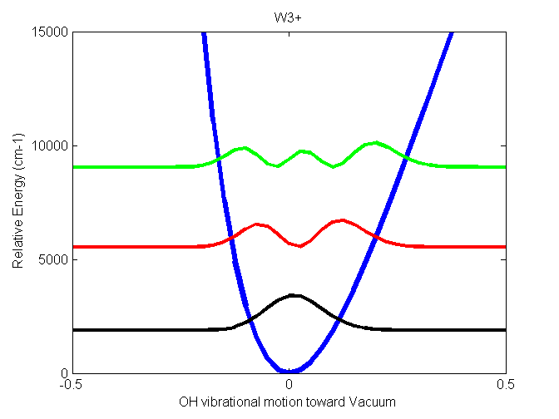
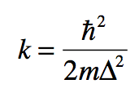
Normal Mode Approx. (NMA)
A simple DVR along normal mode direction (approx.)
PES obtained from ab initio cal. (no approx.)
Diagonalize the (no approx.)
Intensities were calculated via Fermi Golden Rule (no approx.)
We use harmonic grids and cost ~ N_{g}^{D}

Slide 11
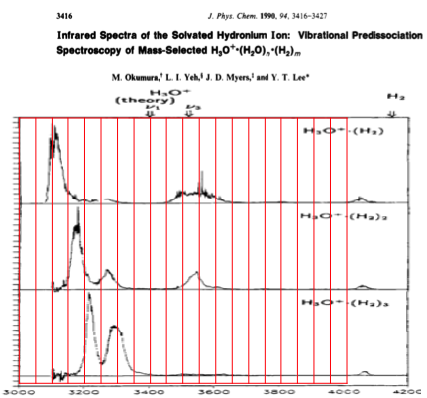

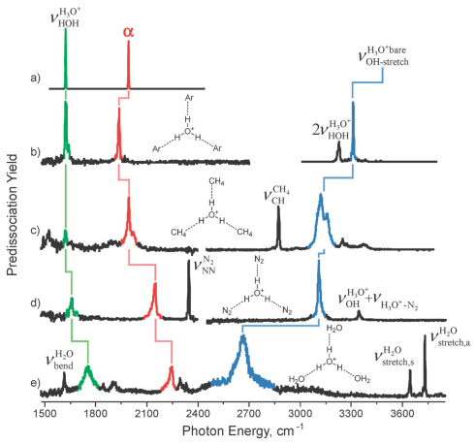
Some Spectra of Solvated H₃O⁺

Slide 12
How many NM is needed? H₃O^{+…}(H₂)_{n}
sym. strech ~3547cm⁻¹
asym. stretch
~3676cm⁻¹
Ar
~3418cm⁻¹
~3491cm⁻¹
N₂
~3284cm⁻¹
~3305cm⁻¹
H₂O
~3009cm⁻¹
~2937cm⁻¹
Harmonic freq by MP2/aug-cc-pvDZ

Slide 13
How many NM is needed? H₃O^{+…}RG₃
bend
~1670 cm⁻¹
sym. strech ~3547cm⁻¹
asym. stretch
~3676cm⁻¹
~1668 cm⁻¹
Ar
~3418cm⁻¹
~3491cm⁻¹
~1692 cm⁻¹
N₂
~3284cm⁻¹
~3305cm⁻¹
~1708 cm⁻¹
H₂O
~3009cm⁻¹
~2937cm⁻¹
Phys. Chem. Chem. Phys., 2012, 14, 7205–7214
Harmonic freq by MP2/aug-cc-pvDZ

Slide 14
Outline
Vib. modes of solvated H₃O⁺ & selected IRPD spectra
Case study on H₃O^{+…}Ar_{1,2&3}
Good Agreements. Let’s make some predictions!
Tuning H-bonds by using different rare gas tagging
Simple pictures derived from H₃O^{+…}RG₃
What else?
JPCA. 119, 10887 (2015)
PCCP. 18, 30721 (2016)

Slide 15
How many NM is needed? H₃O^{+…}(H₂)_{n}
bend
~1670 cm⁻¹
sym. strech ~3547cm⁻¹
asym. stretch
~3676cm⁻¹
~1668 cm⁻¹
Ar
~3418cm⁻¹
~3491cm⁻¹
~1692 cm⁻¹
N₂
~3284cm⁻¹
~3305cm⁻¹
~1708 cm⁻¹
H₂O
~3009cm⁻¹
~2937cm⁻¹
Harmonic freq by MP2/aug-cc-pvDZ

Slide 16
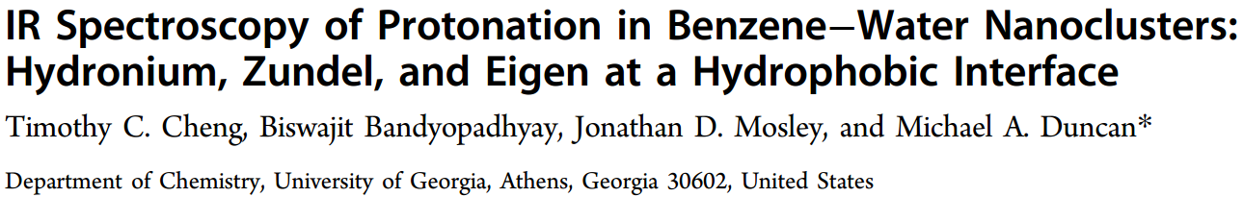
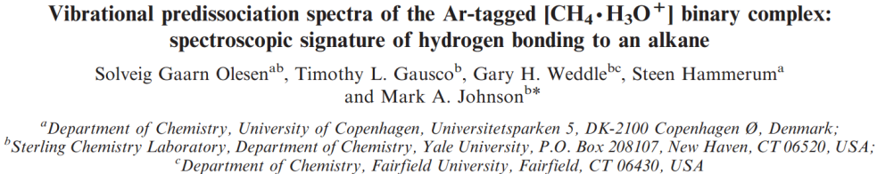
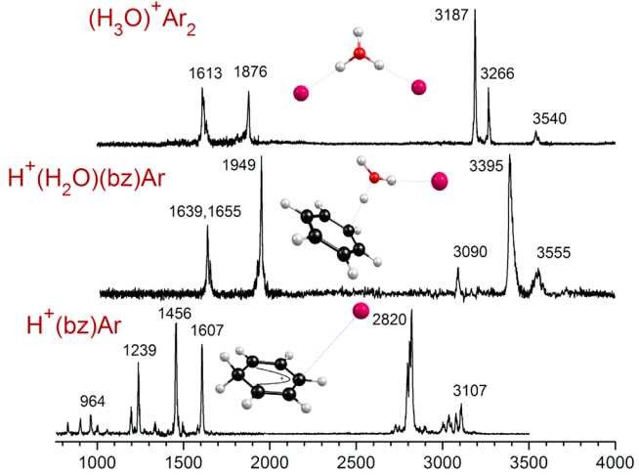
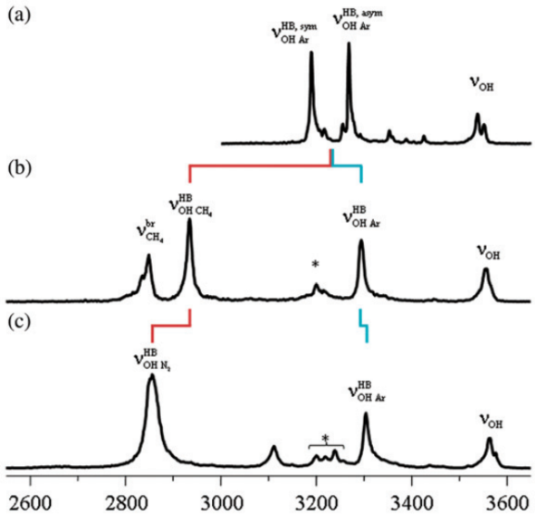
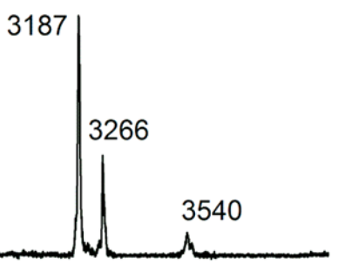
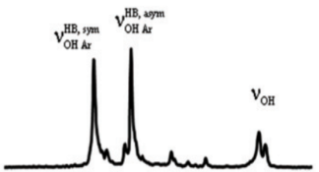


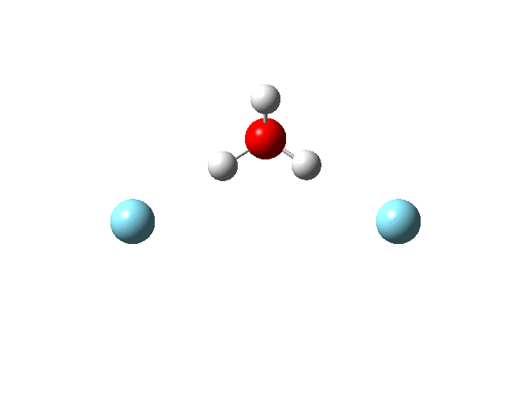
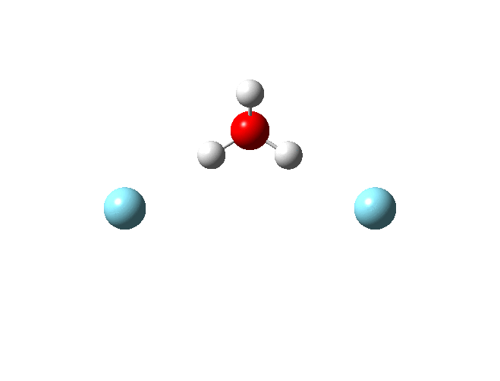
“Splitting” between sym and asym modes
H₃O⁺Ar₂
Sym. & Asym. nearly degenerate.

Slide 17
Normal Mode Approx. (NMA)
A simple DVR along normal mode direction (approx.)
PES obtained from ab initio cal. (no approx.)
Diagonalize the (no approx.)
Intensities were calculated via Fermi Golden Rule (no approx.)
We use harmonic grids and cost ~ N_{g}^{D}

Slide 18
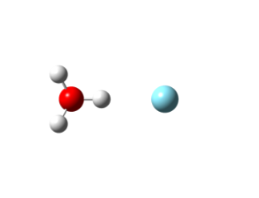
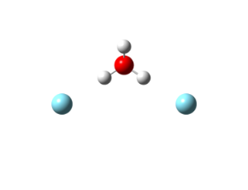
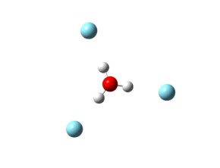
DVR Approach to examine H₃O⁺ (1)
The Coupling among 3stretches
3D (stretch)
H₃O⁺Ar₁
Anti-cooperative tunes O-H…Ar.
H₃O⁺Ar₂
H₃O⁺Ar₃
J. Phys. Chem. A. 119, 10887 (2015)

Slide 19
DVR Approach to examine H₃O⁺ (2)
Fermi-Resonance
5D (bend & stretch)
H₃O⁺Ar₁
Anti-cooperative effect tunes the F-R strength !
H₃O⁺Ar₂
H₃O⁺Ar₃
J. Phys. Chem. A. 119, 10887 (2015)
(2_{bend},0)
(0,1_{stretch})
3200cm⁻¹
(n_{b1},n_{b2},n_{s1},n_{s2},n_{s3})
(2,0,0,0,0) (0,0,1,0,0)
(0,2,0,0,0) (0,0,0,1,0)
(1,1,0,0,0) (0,0,0,0,1)
~3000cm⁻¹
(1_{bend},0)
1600cm⁻¹
(0,0)
GS

Slide 20
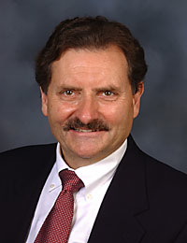
DVR Approach to examine H₃O⁺ (3)
218cm⁻¹
295cm⁻¹
357cm⁻¹
Exp.
J. Phys. Chem. A. 119, 10887 (2015)
Bend overtone + hind. rot.
Comb. band (freq. & intensity)
Anti-cooperative effect tunes the F-R strength !

Slide 21

Conclusions (1)
Reduced dimension DVR leads to good agreements.
Increase # of RG ~ blue-shift O-H stretch, but bends are not sensitive. Change in O-H freq leads to significant change of the IR spectra ~ 3200 cm⁻¹.
Coupling between bending & hinder rotation) makes hinder rotation visible ~ 1900 cm⁻¹.
Other combination modes may appear.
Coupling between bending & hinder rotation) makes hinder rotation visible ~ 1900 cm⁻¹. ???
J. Phys. Chem. A. 119, 10887 (2015)

Slide 22
Outline
Vib. modes of solvated H₃O⁺ & selected IRPD spectra
Case study on H₃O^{+…}Ar_{1,2&3}
Good Agreements. Let’s make some predictions!
Tuning O-H..X by using different rare gas tagging
Simple pictures derived from H₃O^{+…}RG₃
What else?
JPCA. 119, 10887 (2015)
PCCP. 18, 30721 (2016)

Slide 23
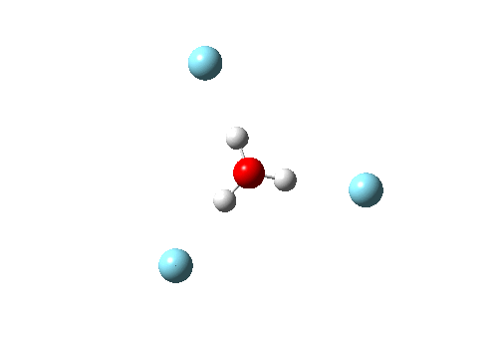
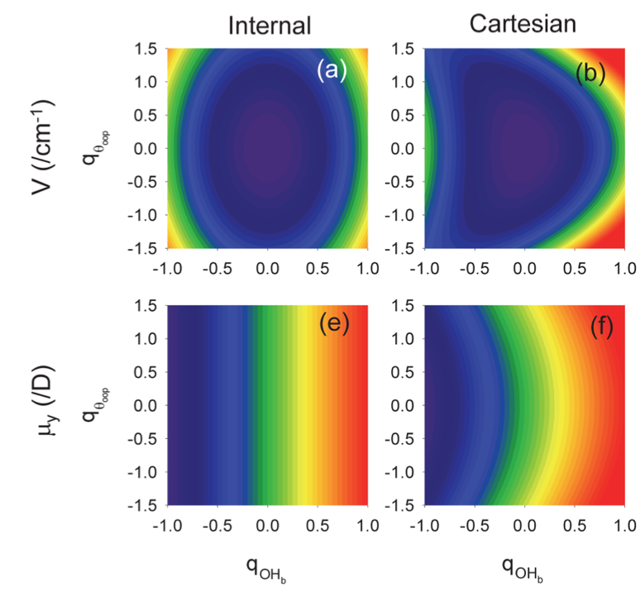
Association motion (bending + hinder rot)
Mechanical or Electronic anharmonicity ?
Local or Normal modes?
J. Phys. Chem. B 2014, 118, 8286−8294
Phys. Chem. Chem. Phys., 2012, 14, 7205–7214

Slide 24
IR Spectra of H₃O^{+…}RG₃ (I)
PCCP. 18, 30721 (2016)
Tuning H-bond strength to modulate F-R !!

Slide 25
IR Spectra of H₃O^{+…}RG₃ (II)
PCCP. 18, 30721 (2016)
comb. band (both freq. & intensity increases). Int >> Int

Slide 26

Fermi Resonance in H₃O^{+…}RG₃
FR in H₃O^{+..}RG₃ can be approximated by two 2-level systems. From peak positions & intensities, we can then extract coupling constants directly.
s₃ (e)
33~42 cm⁻¹
|0 0 1>
(e)
|0 0 1>
<0 2|,<2 0|,<11|
<0 2|,<2 0|,<11|
|0 1 0>
(e)
|0 1 0>
s₂ (e)
(e)
(a₁)
(a₁)
b₁ (e)
a₁
|1 0 0>
|1 0 0>
25~30 cm⁻¹
b₂ (e)
<0 1|
<1 0|
s₁(a₁)
PCCP. 18, 30721 (2016)
<b_{1,}b₂|
<0 0 |
|0 0 0>
|s_{1,}s_{2,}s₃>

Slide 27
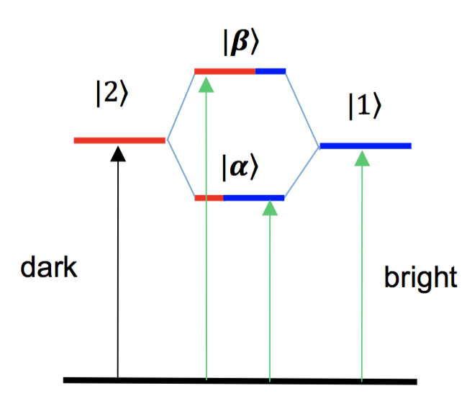
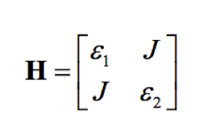
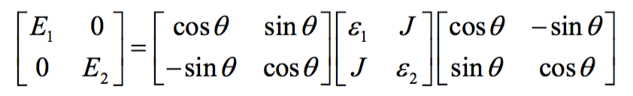
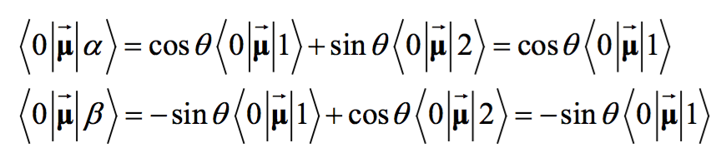
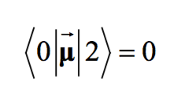
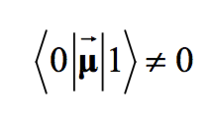
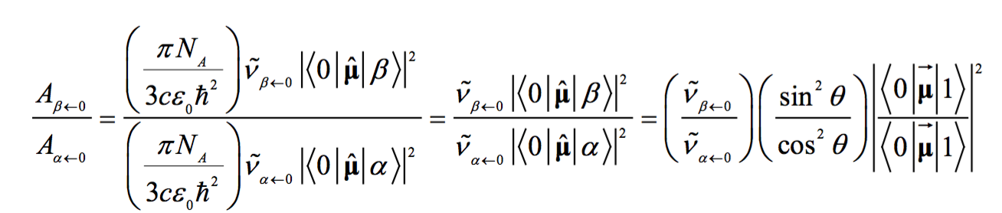
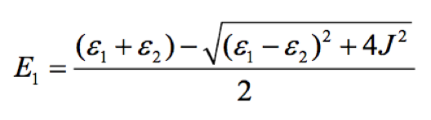
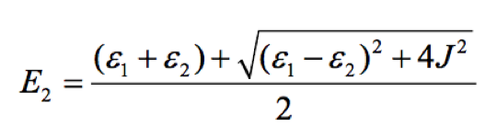
Understanding FR via a simple two-level system

Slide 28
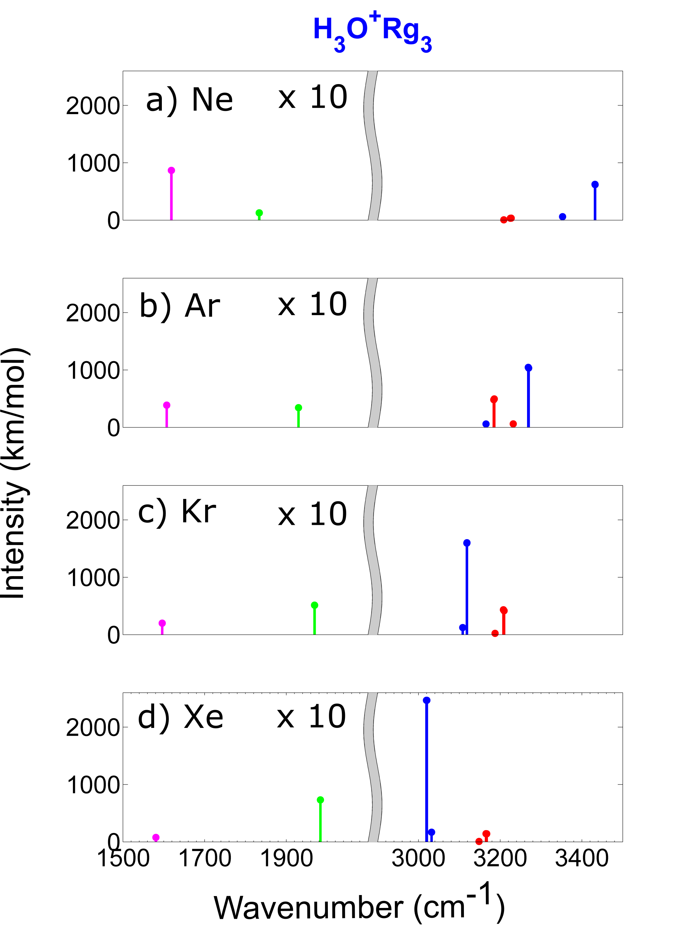
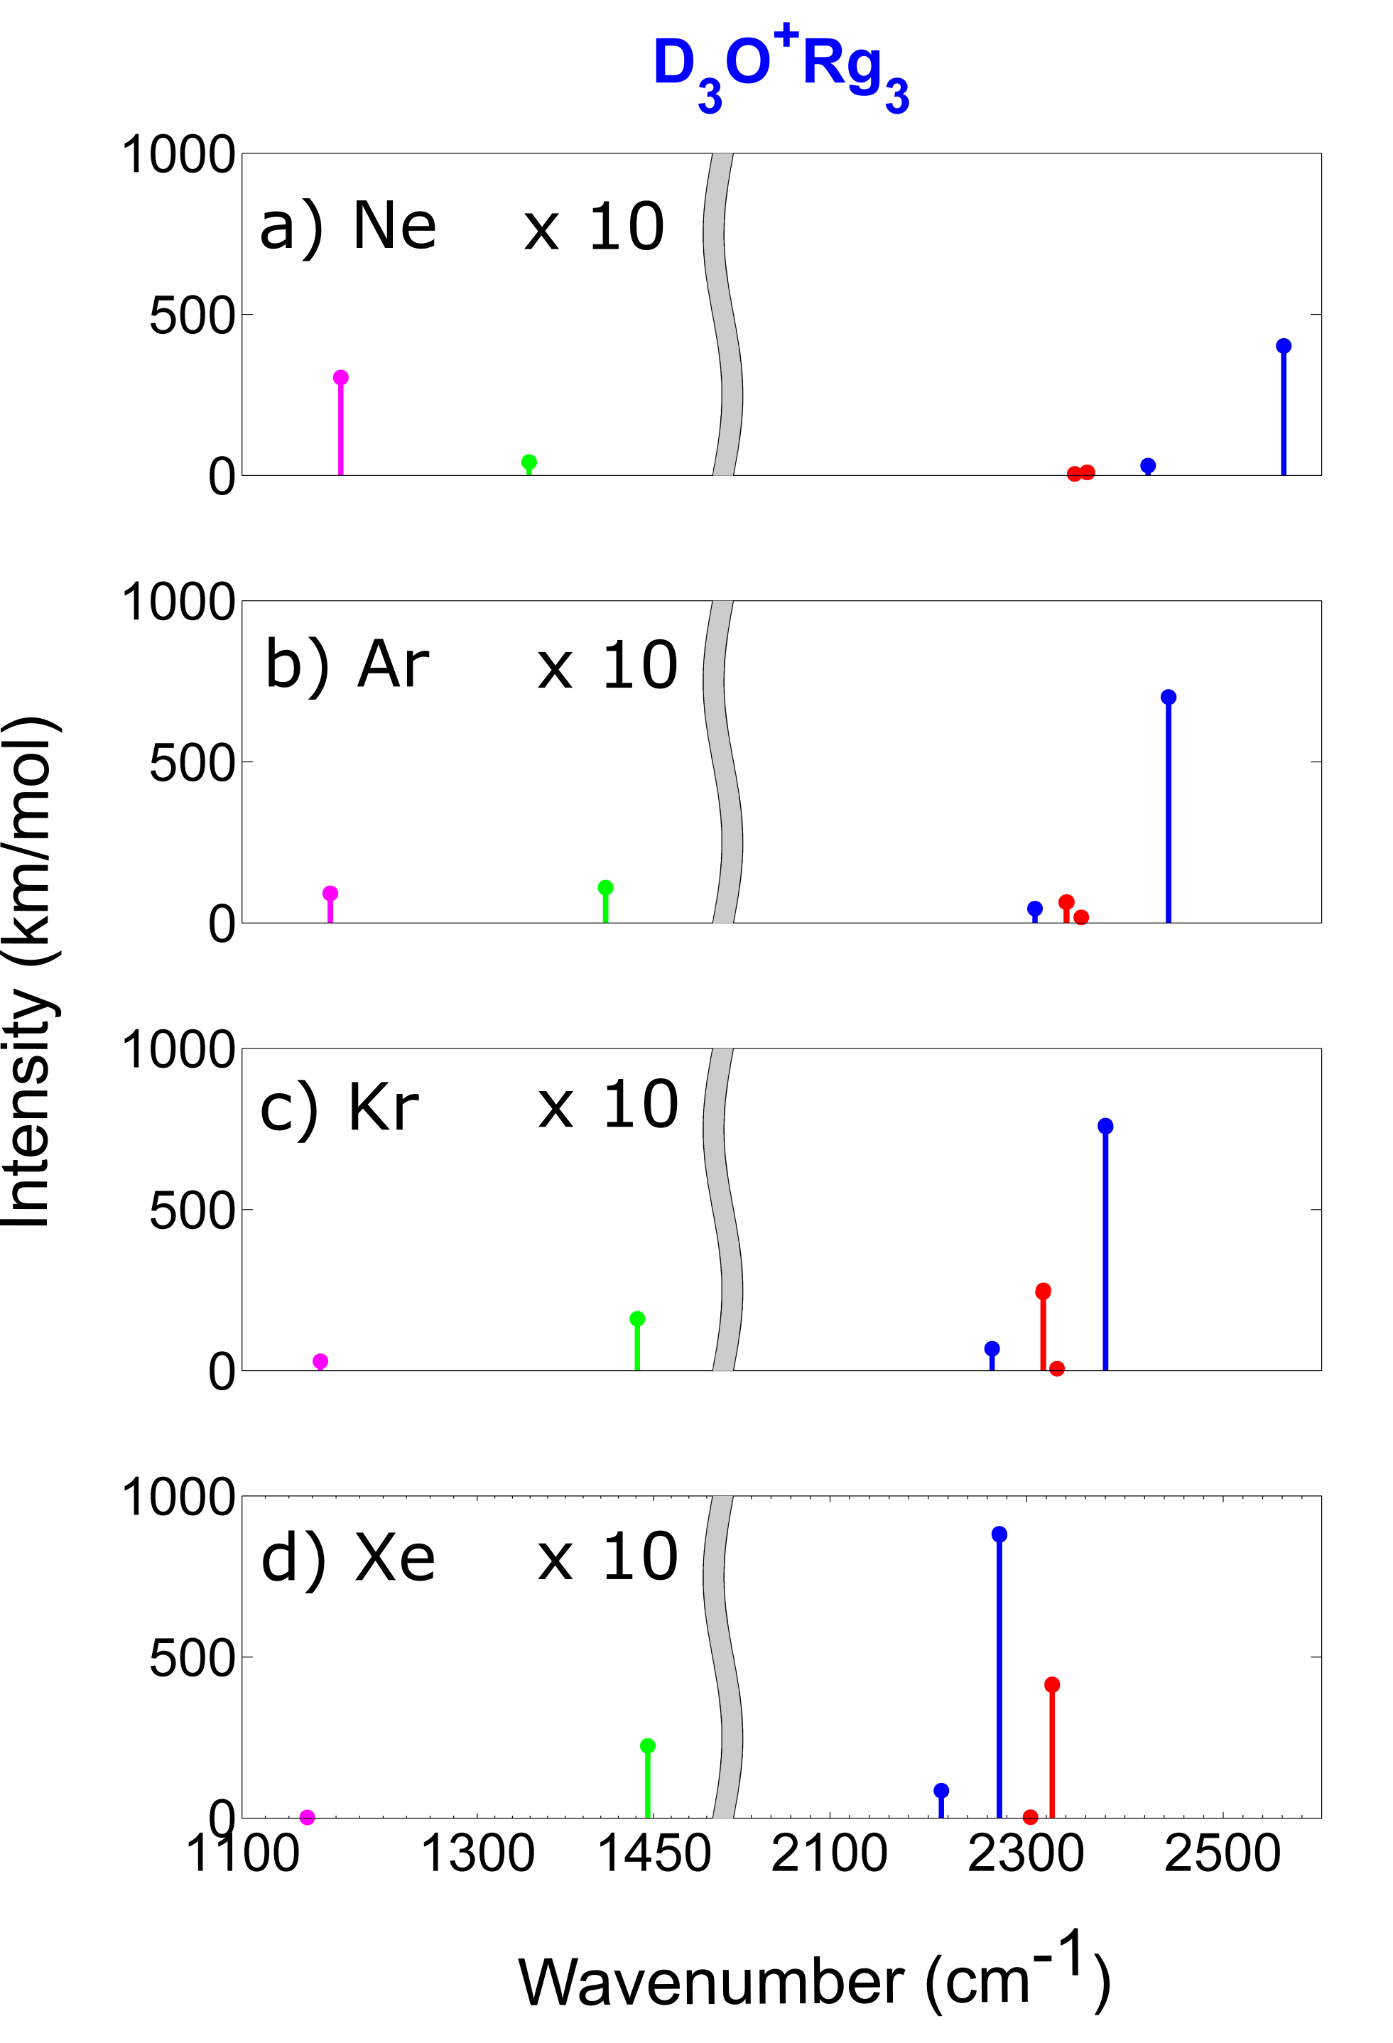
Reducing a 6x6 to two sets of 2x2 matrix

Slide 29
Comb. Band (hinder rot. & bend)
s₃ (e)
b₁ (e)
φ(a₂)
s₂ (e)
b₂ (e)
|<φ, b_{1,}b_{2,},s_{1,}s_{2,}s₃|Φ>|²
|<1, 1, 0, 0, 0, 0 |Φ>|² ~ 61– 89%
s₁(a₁)
|<3, 1, 0, 0, 0, 0 |Φ>|² ~ 14 – 3%
|<0, 0, 0, 0, 1, 0 |Φ>|² ~ 1 – 3%
PCCP. 18, 30721 (2016)
|<0, 0, 0, 0, 1, 0 |Φ>|² ~ 1 – 3% The only intensity carrier
|<3, 1, 0, 1, 0, 0 |Φ>|² ~ 5 – 1%
|<2, 0, 0, 0, 1, 0 |Φ>|² ~ 1 – 2%
Intensity of these combination modes are borrowed from asymmetric stretch modes.

Slide 30
Conclusions (2)
Rare gas can effectively tune the solvation of H₃O⁺.
Vibration couplings among stretch and bending in H₃O^{+…}RG₃ is sensitive to the change of solvation.
Fermi Resonance is 30~40 cm⁻¹ in H₃O^{+…}RG₃ & 16~30 cm⁻¹ in D₃O+…RG₃.
Combination modes (bending + hinder rotation) couple with O-H stretch and borrows their intensities.
PCCP. 18, 30721 (2016)

Slide 31
Outline
Quick review on H₃O^{+…}Ar_{1,2&3}
Good Agreements. Let’s make some predictions!
Tuning H-bonds by using different rare gas tagging
Exp. observables in H₃O^{+…}RG₃
What else?
JPCA. 119, 10887 (2015)
PCCP. 18, 30721 (2016)

Slide 32
A subset of 3N-6 Normal Modes of H₃O^{+…}X₃ (1)
Ar ~ H₂O
(s₁, s₂, s₃) stretch of O-H bond (~in-plane) 3490 ~ 2900
(b₁, b₂, Φ) bend of H-O-H (~in-plane) 1670 ~ 1710
hinder rotation of H₃O⁺ 340 ~ 720
(b₁, b₂, ) bend of H-O-H (~in-plane)
(u, R₁, R₂) umbrella motion of H₃O⁺(out-of-plane) 900 ~ 1200
rocking of H₃O⁺ 370 ~ 970
(u, ) umbrella motion of H₃O⁺(out-of-plane)
(S₁, S₂, S₃) stretch of O…X bond (~in-plane)
translational motion of H₃O⁺ 100 ~ 340
Rotation of H₃O⁺
(z)
bend
~1670 cm⁻¹
sym. strech ~3547cm⁻¹
asym. stretch
~3676cm⁻¹
Ar
~338 cm⁻¹
~1668 cm⁻¹
~3418cm⁻¹
~3491cm⁻¹
N₂
~557 cm⁻¹
~1692 cm⁻¹
~3284cm⁻¹
~3305cm⁻¹
H₂O
~725 cm⁻¹
~1708 cm⁻¹
~3009cm⁻¹
~2937cm⁻¹
Harmonic freq by MP2/aug-cc-pvDZ

Slide 33
3N-6 Normal Modes of H₃O^{+…}X₃
Ar ~ H₂O
(s₁, s₂, s₃) stretch of O-H bond (~in-plane) 3490 ~ 2900
(b₁, b₂, Φ) bend of H-O-H (~in-plane) 1670 ~ 1710
hinder rotation of H₃O⁺ 340 ~ 720
(b₁, b₂, ) bend of H-O-H (~in-plane)
(u, R₁, R₂) umbrella motion of H₃O⁺(out-of-plane) 900 ~ 1200
rocking of H₃O⁺ 370 ~ 970
(u, ) umbrella motion of H₃O⁺(out-of-plane)
(S₁, S₂, S₃) stretch of O…X bond (~in-plane)
translational motion of H₃O⁺ 100 ~ 340
(B₁, B₂, ) bend of X…O…X (~in-plane) < 50
(B₁, B₂, ) bend of X…O…X (~in-plane) < 50
(U, ) umbrella motion of H₃O⁺(out-of-plane) < 50
(U, ) umbrella motion of H₃O⁺(out-of-plane) < 50

Slide 34
A subset of 3N-6 Normal Modes of H₃O^{+…}X₃ (2)
Ar ~ H₂O
(s₁, s₂, s₃) stretch of O-H bond (~in-plane) 3490 ~ 2900
(b₁, b₂, Φ) bend of H-O-H (~in-plane) 1670 ~ 1710
hinder rotation of H₃O⁺ 340 ~ 720
(b₁, b₂, ) bend of H-O-H (~in-plane)
(u, R₁, R₂) umbrella motion of H₃O⁺(out-of-plane) 900 ~ 1200
rocking of H₃O⁺ 370 ~ 970
(S₁, S₂, S₃) stretch of O…X bond (~in-plane)
translational motion of H₃O⁺ 100 ~ 340
Rotation of H₃O⁺
(x,y)
umbrella ~904 cm⁻¹
sym. strech ~3547cm⁻¹
asym. stretch
~3676cm⁻¹
Ar
~368 cm⁻¹
~962 cm⁻¹
~3418cm⁻¹
~3491cm⁻¹
N₂
~617 cm⁻¹
~1013 cm⁻¹
~3284cm⁻¹
~3305cm⁻¹
H₂O
~975 cm⁻¹
~1202 cm⁻¹
~3009cm⁻¹
~2937cm⁻¹
Harmonic freq by MP2/aug-cc-pvDZ

Slide 35
A subset of 3N-6 Normal Modes of H₃O^{+…}X₃ (3)
Ar ~ H₂O
(s₁, s₂, s₃) stretch of O-H bond (~in-plane) 3490 ~ 2900
(b₁, b₂, Φ) bend of H-O-H (~in-plane) 1670 ~ 1710
hinder rotation of H₃O⁺ 340 ~ 720
(b₁, b₂, ) bend of H-O-H (~in-plane)
(u, R₁, R₂) umbrella motion of H₃O⁺(out-of-plane) 900 ~ 1200
rocking of H₃O⁺ 370 ~ 970
(u, ) umbrella motion of H₃O⁺(out-of-plane)
(S₁, S₂, S₃) stretch of O…X bond (~in-plane)
translational motion of H₃O⁺ 100 ~ 340
Translation of H₃O⁺
sym. strech ~3547cm⁻¹
asym. stretch
~3676cm⁻¹
Ar
~ 100cm⁻¹
~ 150cm⁻¹
~3418cm⁻¹
~3491cm⁻¹
N₂
~ 175 cm⁻¹
~ 228cm⁻¹
~3284cm⁻¹
~3305cm⁻¹
H₂O
~ 285 cm⁻¹
~ 344cm⁻¹
~3009cm⁻¹
~2937cm⁻¹
Harmonic freq by MP2/aug-cc-pvDZ

Slide 36
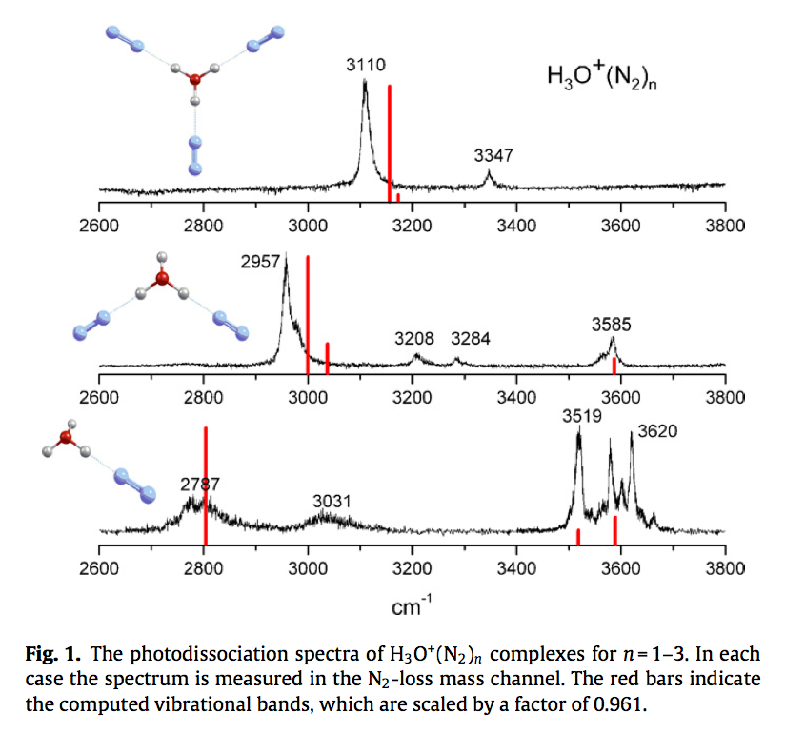

Slide 37
Association motion (bending + hinder rot)
Phys. Chem. Chem. Phys., 2012, 14, 7205–7214

Slide 38
Outline
Quick review on H₃O^{+…}Ar_{1,2&3}
Good Agreements. Let’s make some predictions!
Tuning H-bonds by using different rare gas tagging
Exp. observables in H₃O^{+…}RG₃
What else?
JPCA. 119, 10887 (2015)
PCCP. 18, 30721 (2016)

Slide 39
Breaking Symmetry
D

Slide 40
3N-6 Normal Modes of H₃O^{+…}X₃
Ar ~ H₂O
(s₁, s₂, s₃) stretch of O-H bond (~in-plane) 3490 ~ 2900
(b₁, b₂, Φ) bend of H-O-H (~in-plane) 1670 ~ 1710
hinder rotation of H₃O⁺ 340 ~ 720
(b₁, b₂, ) bend of H-O-H (~in-plane)
(u, R₁, R₂) umbrella motion of H₃O⁺(out-of-plane) 900 ~ 1200
rocking of H₃O⁺ 370 ~ 970
(u, ) umbrella motion of H₃O⁺(out-of-plane)
(S₁, S₂, S₃) stretch of O…X bond (~in-plane)
translational motion of H₃O⁺ 100 ~ 340
(B₁, B₂, ) bend of X…O…X (~in-plane) < 50
(B₁, B₂, ) bend of X…O…X (~in-plane) < 50
(U, ) umbrella motion of H₃O⁺(out-of-plane) < 50
(U, ) umbrella motion of H₃O⁺(out-of-plane) < 50

Slide 41
Association motion (bending + hinder rot)
Phys. Chem. Chem. Phys., 2012, 14, 7205–7214

Slide 42
A subset of 3N-6 Normal Modes of H₃O^{+…}X₃
Ar ~ H₂O
(s₁, s₂, s₃) stretch of O-H bond (~in-plane) 3490 ~ 2900
(b₁, b₂, Φ) bend of H-O-H (~in-plane) 1670 ~ 1710
hinder rotation of H₃O⁺ 340 ~ 720
(b₁, b₂, ) bend of H-O-H (~in-plane)
(u, R₁, R₂) umbrella motion of H₃O⁺(out-of-plane) 900 ~ 1200
rocking of H₃O⁺ 370 ~ 970
(S₁, S₂, S₃) stretch of O…X bond (~in-plane)
translational motion of H₃O⁺ 100 ~ 340
Rotation of H₃O⁺
(z)
bend
~1670 cm⁻¹
sym. strech ~3547cm⁻¹
asym. stretch
~3676cm⁻¹
Ar
~338 cm⁻¹
~1668 cm⁻¹
~3418cm⁻¹
~3491cm⁻¹
N₂
~557 cm⁻¹
~1692 cm⁻¹
~3284cm⁻¹
~3305cm⁻¹
H₂O
~725 cm⁻¹
~1708 cm⁻¹
~3009cm⁻¹
~2937cm⁻¹
Harmonic freq by MP2/aug-cc-pvDZ

Slide 43
Treating a subset of Normal Modes H₃O^{+…}RG₃
Rotation of H₃O⁺
(x,y)
umbrella ~904 cm⁻¹
sym. strech ~3547cm⁻¹
asym. stretch
~3676cm⁻¹
Ar
~368 cm⁻¹
~962 cm⁻¹
~3418cm⁻¹
~3491cm⁻¹
N₂
~617 cm⁻¹
~1013 cm⁻¹
~3284cm⁻¹
~3305cm⁻¹
H₂O
~975 cm⁻¹
~1202 cm⁻¹
~3009cm⁻¹
~2937cm⁻¹
Harmonic freq by MP2/aug-cc-pvDZ

Slide 44
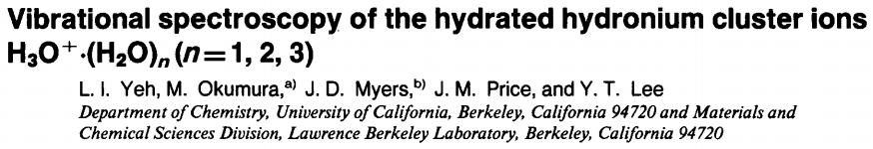
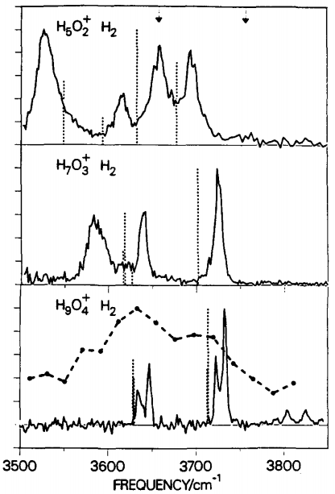
Spectra of Solvated H₃O⁺

Slide 45
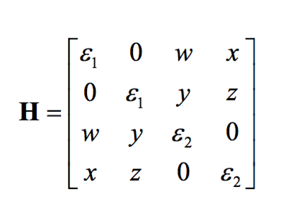
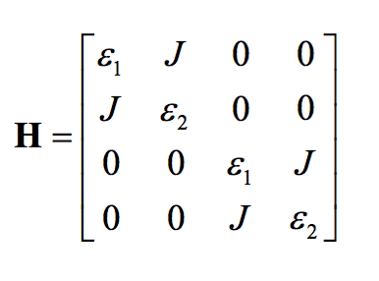
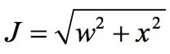
Reducing a 6x6 to two sets of 2x2 matrix
(e)
(e)
Complexes | Fermi resonance type
 | a₁ ↔ a₁ |  | e ↔ e
 | J (cm⁻¹) | Δε(cm⁻¹) | J (cm⁻¹) | Δε(cm⁻¹)
H₃O^{+..}Ne₃ | 40.21 | -119.31 | 41.45 | -188.91
H₃O^{+..}Ar₃ | 33.28 | -1.59 | 39.34 | -30.32
H₃O^{+..}Kr₃ | 28.76 | 54.51 | 36.76 | 52.29
H₃O^{+..}Xe₃ | 24.34 | 105.48 | 33.13 | 130.18
D₃O^{+..}Ne₃ | 25.32 | -54.92 | 29.94 | -190.80
D₃O^{+..}Ar₃ | 21.15 | 20.61 | 28.87 | -86.27
D₃O^{+..}Kr₃ | 18.65 | 54.70 | 27.29 | -32.35
D₃O^{+..}Xe₃ | 16.36 | 84.59 | 25.04 | 19.36

Slide 46
Freq. of Normal Modes H₃O^{+…}RG₃ (2)
Harmonic freq by MP2/aug-cc-pvDZ
Rotation of H₃O⁺
Translation of H₃O⁺
Ar
~368 cm⁻¹
~338 cm⁻¹
~ 100cm⁻¹
~ 150cm⁻¹
N₂
~617 cm⁻¹
~557 cm⁻¹
~ 175 cm⁻¹
~ 228cm⁻¹
H₂O
~975 cm⁻¹
~725 cm⁻¹
~ 285 cm⁻¹
~ 344cm⁻¹
Harmonic freq by MP2/aug-cc-pvDZ

